Slide 1
METAVERSE
TECHSPIDERS

Slide 2
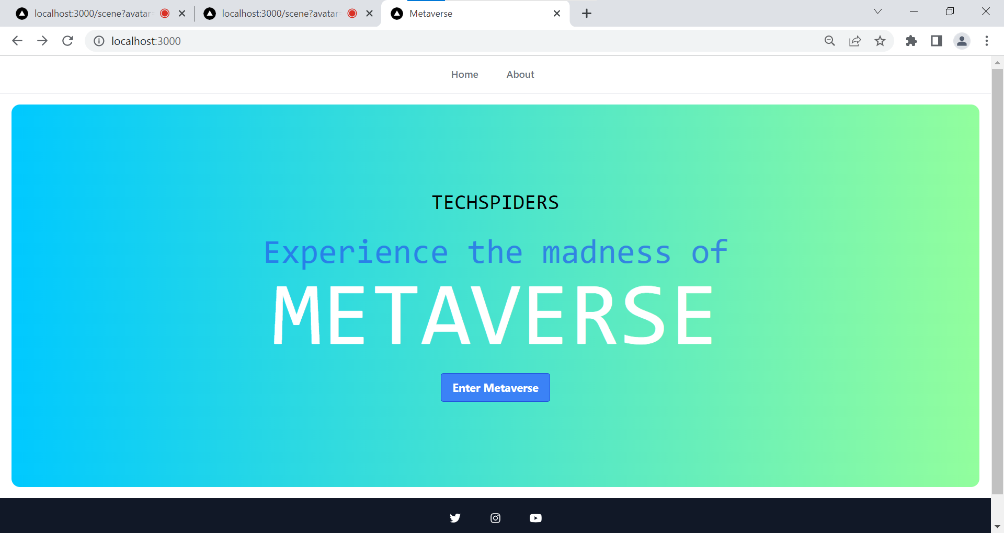

Slide 3
Project Goals Aligning with Business Value for SONY
Goal 1
Goal 2
Goal 3
Enhance employee engagement
Enhance customer satisfaction
ENABLING PARTICIPATION IN SONY GLOBAL EVENTS
To develop a platform which enables SONY employee to connect NOT with just audio/video but WITH ALSO actions /emotions /expressions
To develop a platform that can showcase SONY products and its features better than life-like manner.
To develop a platform that enables participation into SONY Events regardless of geographic location while delivering life like experience.

Slide 4


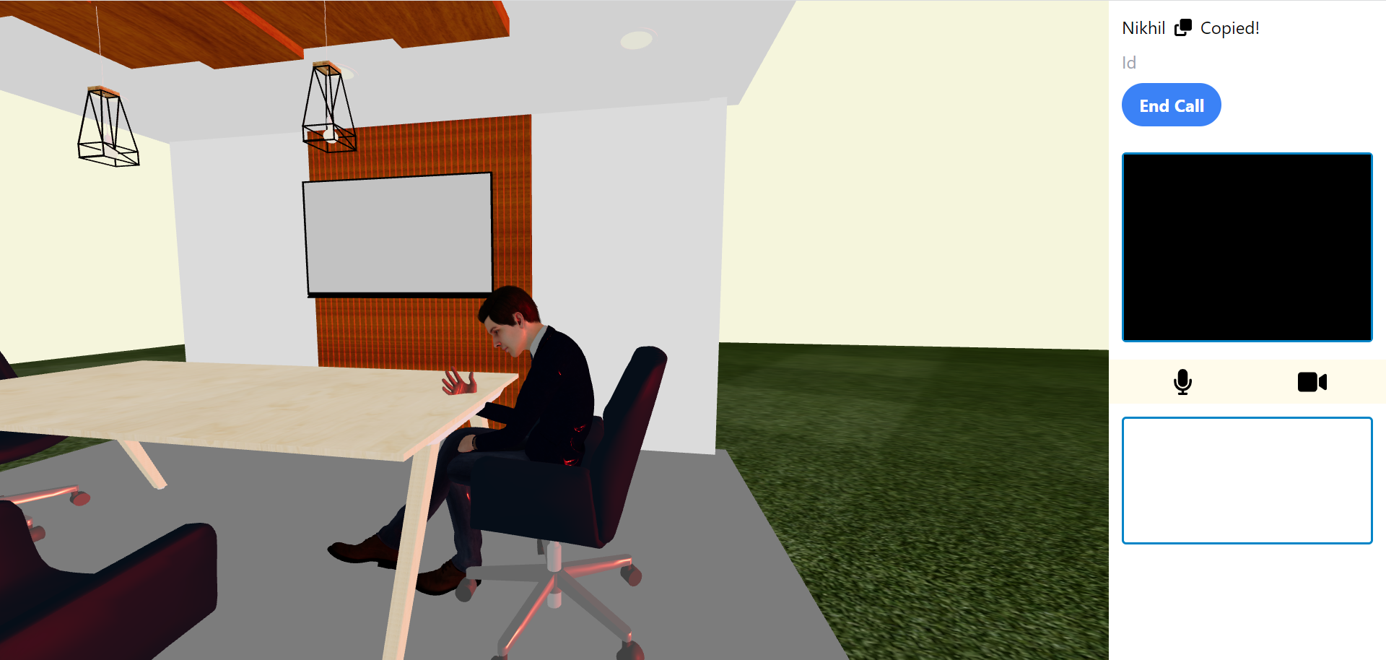
Objectives achieved till date
As of now, two users can connect with each other on the metaverse platform using their AVATARS and interact using audio/video/actions*.
RESOURCES REQUIRED : Laptop/Desktop, Good Internet Connection

Slide 5


TECHNOLOGIES USED
3D DESIGN
Blender
Mixamo
DEVELOPMENT
Typescript
Tailwind CSS
ReactJS, ThreeJS, NextJS
NodeJS, PeerJS
Socket.io

Slide 6
Project Flow
Use on Landing Page & Clicks ‘Enter Metaverse’
User prompted to choose Avatar and Enter Name
User Avatar Created and Enters the meeting room scene
User enters target client ID to establish call
Target user accepts call to complete the connection.
Avatar created can be controlled by user and interaction can be done using voice/video/action

Slide 7
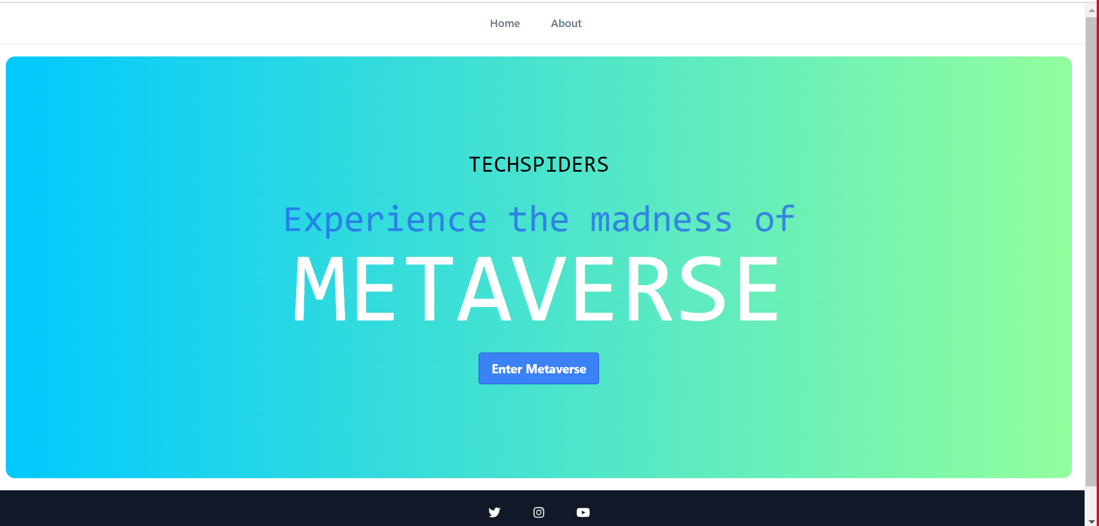
Screen Flow

Slide 8
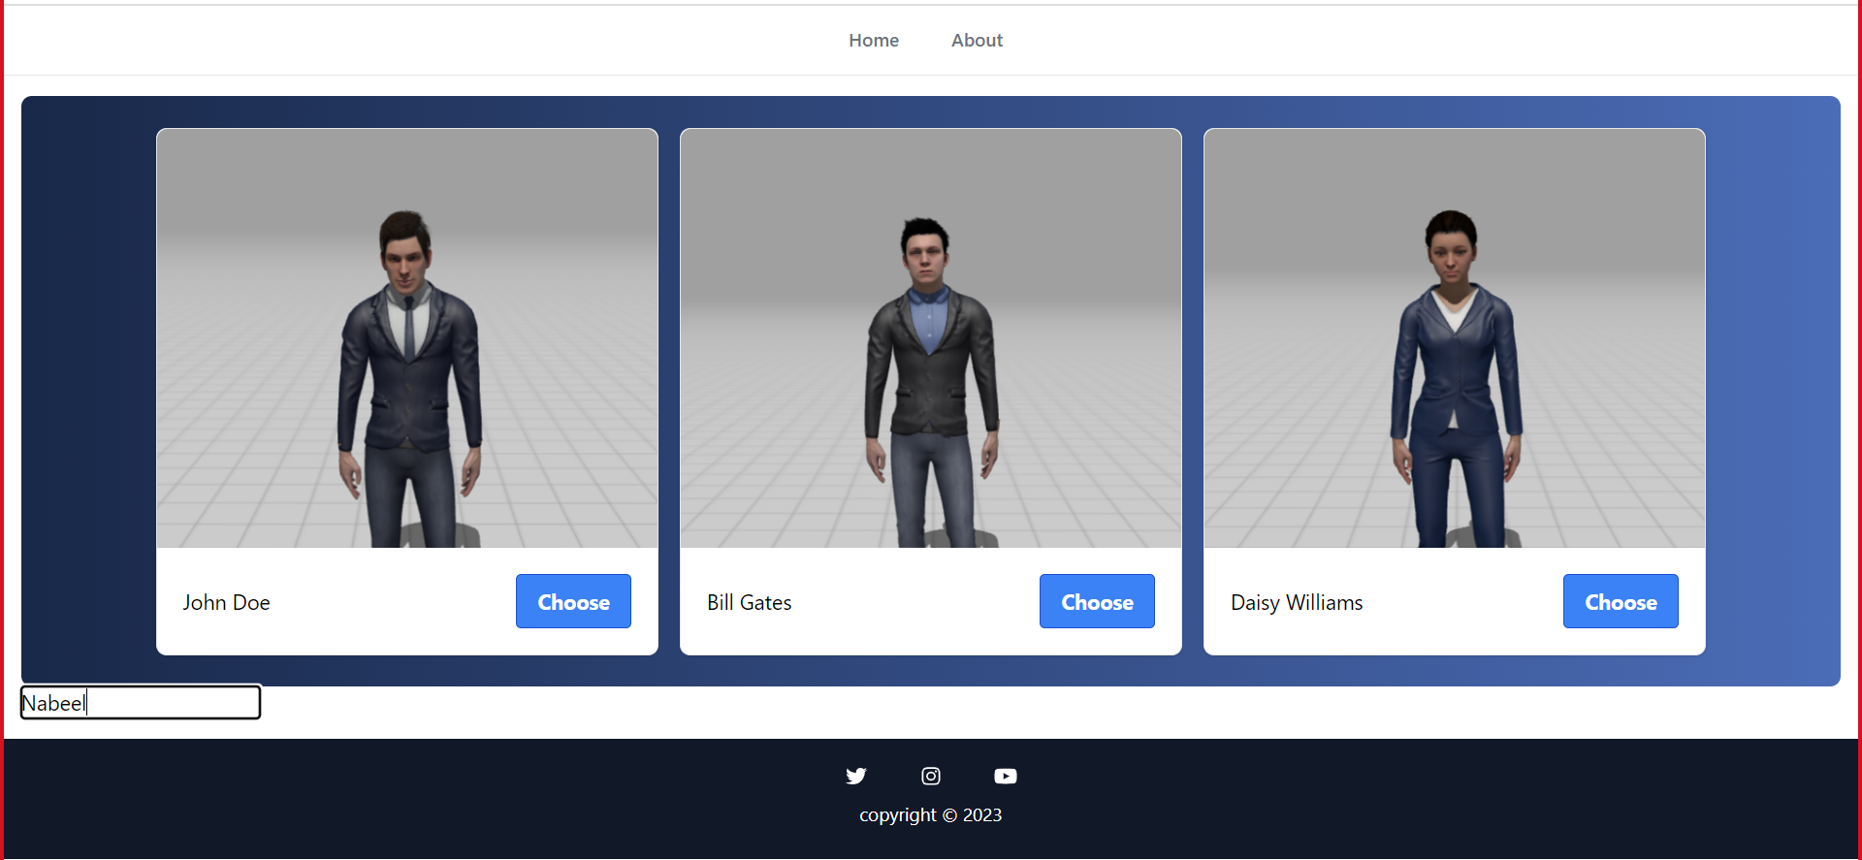
Screen Flow

Slide 9
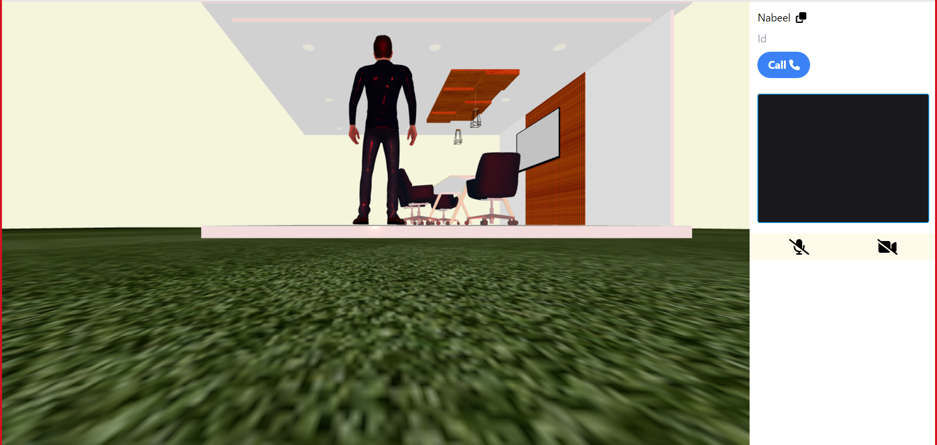
Screen Flow

Slide 10

Screen Flow

Slide 11
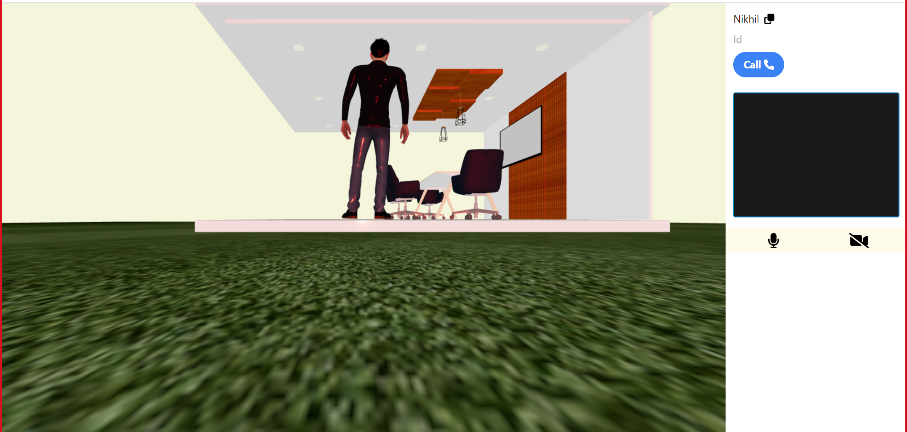
Screen Flow

Slide 12
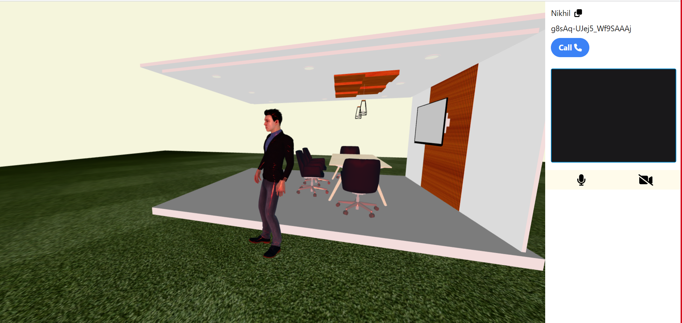
Screen Flow

Slide 13
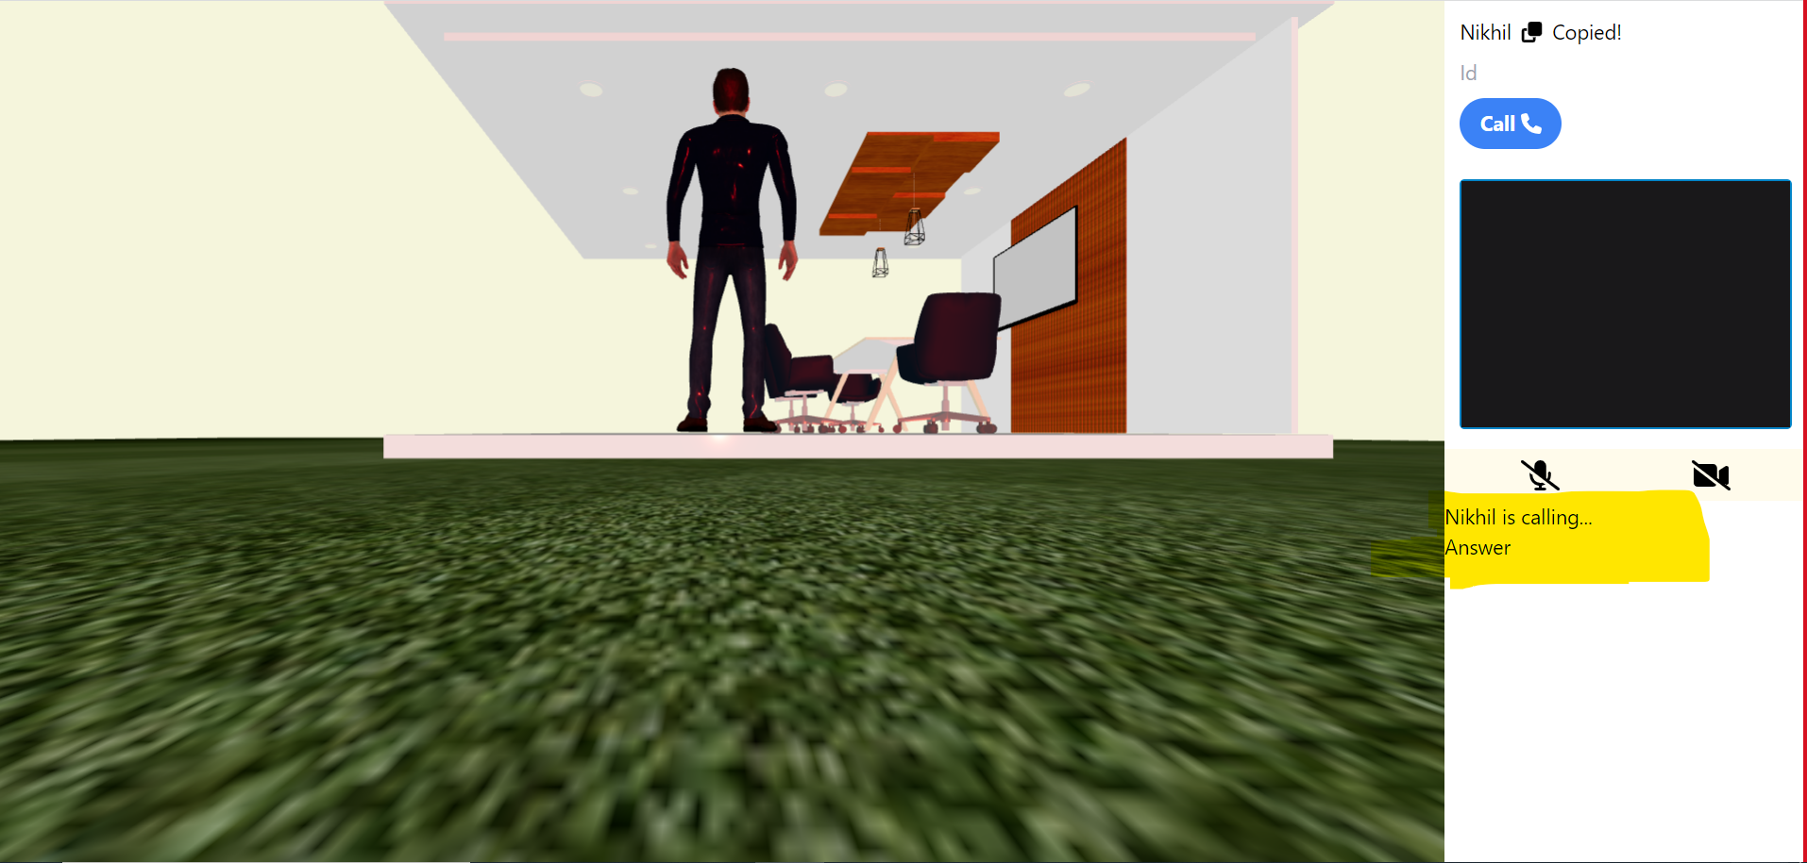
Screen Flow

Slide 14
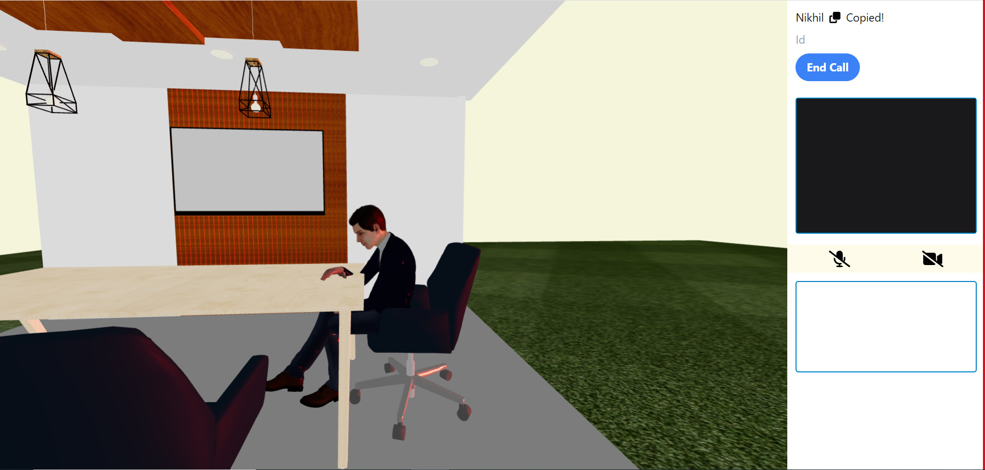
Screen Flow

Slide 15

Impact
The primary impact of the idea is to fill the SONY employee collaborations with more emotions and providing them a better interactive experience in this hybrid work culture

Slide 16
Thank you
TEAM TECHSPIDERS
Nikhil Garg
Ghulam Nabeel
Masum Chaudhuri

